Slide 1
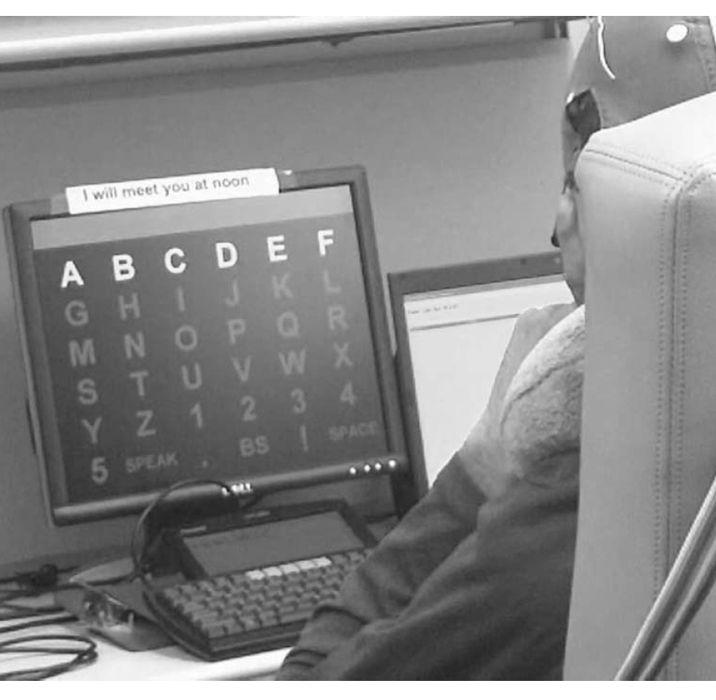
Usability of brain-machine devices for communication
Shraddha Swaroop, California State University, Long Beach
Notes:
My research is on the usability of brain-machine devices specifically for communication. As you can see from this picture, this person is wearing a helmet and is sitting in front of a screen with many letters on it. What you don’t see in this picture is that this person is suffering from Locked In Syndrome. These people are unable to communicate in the traditional ways because the lose their voice and all motor function but they are completely alert and aware of the environment around them. As you can imagine this can be very isolating. So this device allows this individual a way to connect with the people and world around him by allowing him to communicate or spell out messages by focusing on one letter at a time to do so. How you might ask? Under his cap there are electroencephalagram or EEG electrodes attached to his scalp. These monitor brain activity (the selective attention) and that connects with the device and information shown on screen.
This is a great idea as long as it works, right? My research was on the second part: the usability of this product and on design recommendations to make it better. As I conducted my research the clinical research from engineers and biologists showed a lot of articles and experiments that these devices were wonderful and a true boon to this population. This picture represents those people. But the usability of this product was barely touched upon and when it was done there were huge problems that needed to fixed.

Slide 2
Review
Articles on clinical/engineering feasibility
Articles of usability for people with the disease

Slide 3
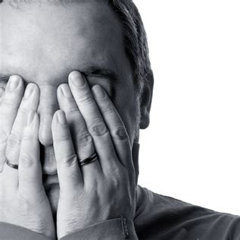
Results
Anxiety & fatigue: Speller app flickering 300 selection per minute
Texting ability needed between caregivers and patients

Slide 4
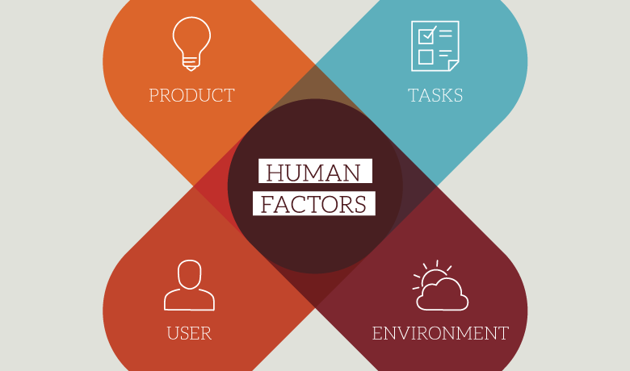
Design recommendations
Research the users needs and task they need to perform
Recognize environments they use their device in
Work with engineers to accomplish users end goal

Slide 5
Concerns
Experimental design
How would I find this user population?
How would I find people who use this app?
Would these people be able to fill out the anxiety survey?

