Slide 1
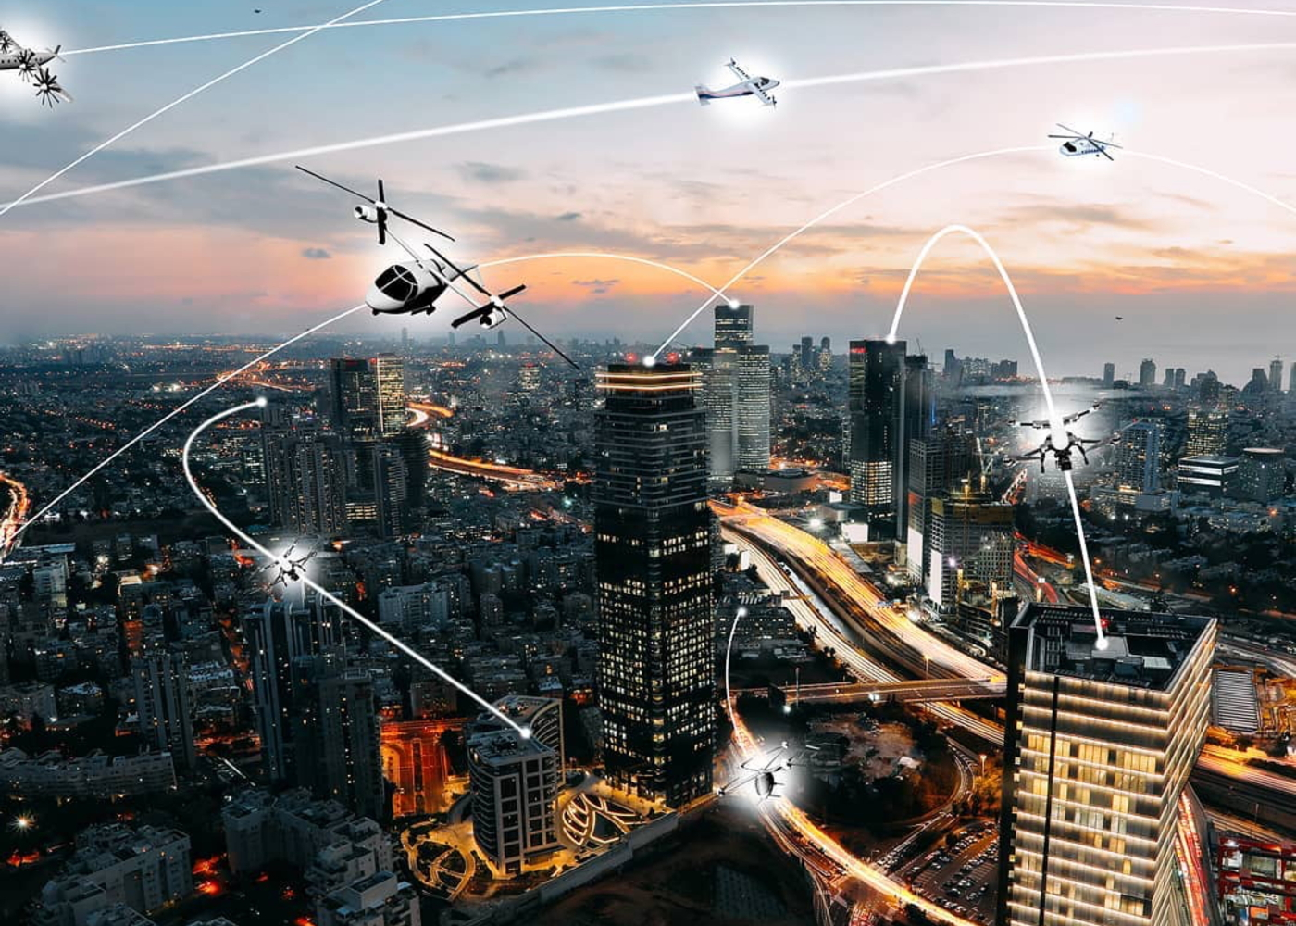
Communication during flight tests
HIGH DENSITY VERTIPLEX (HDV)TEAM WORKS ON THE URBAN AIR MOBILITY CONCEPT DOING FLIGHT TESTS
Shraddha Swaroop
Notes:
My project started off as creating a data visualization tool for the High Density Vertiplex team at NASA-Ames who is one of many teams working on the Urban Air Mobility concept, which seeks to safely and efficiently move cargo and people in the urban areas. This is popularly knows as the air taxi concept which is meant to alleviate road traffic and replace it with aviation. HDV works on the terminals and air traffic management.

Slide 2
High Density Vertiplex
Project: Data visualization tool for the High Density Vertiplex (HDV) team
Goal: Provide researchers with a tool for easy access to data visualization to provide accurate, effective and full understanding of the live flight and simulated flight research that is done on a semi-annual basis. This tool will provide data-driven solutions for air traffic management system for the HDV project
Notes:
Initially my project was to create a data visualization tool for this team and provide researchers with a tool for easy access to data visualization to help them understand live and simulated flight data.

Slide 3
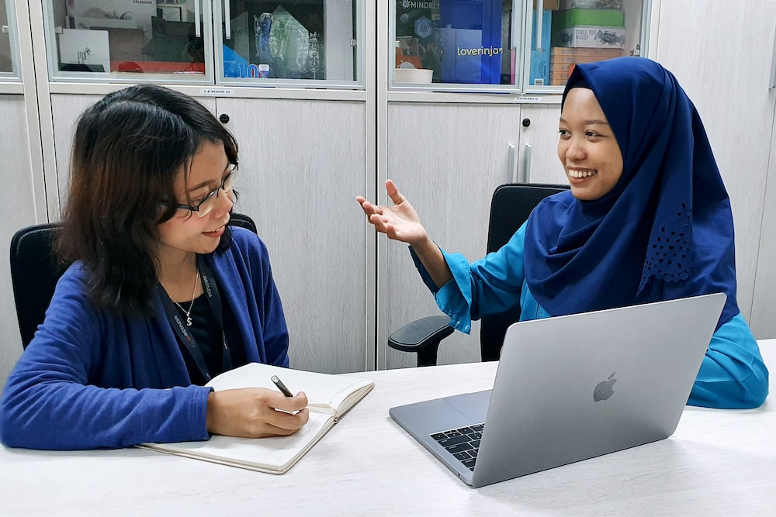
Objectives
Generate
Generate a list of common pain points and goals of users that may impact the development of data visualization tool by October 2022 will allow me to create an easy-to-use tool.
Activity: Interview 5 key users of the last live flight test to understand workflow analysis for both tech leads and researcher groups
Develop
Develop prototype by November 2022 based on the needs of the users to provide a tool to help them improve team situation awareness to keep flight tests on track.
Activity: Create mockups that will be part of the prototype that will be created using Adobe XD
Notes:
The objectives include generating a list of common pain points and goals of users that may impact the tool. We will do that by interviewing 5 key users of the tool in October 2022
As I was doing that step, 60 percen of my users pointed out gaps in communication were creating problems with team situation awareness so I switched my focus to creating a solution for this communication issue. Although the research did provide recommendations and requirements for a data visualization tool too. The prototype I developed was for a communication tool to boost team situation awareness.

Slide 4
Human Factors Methodologies
Work flow analysis:
Interviews will reveal current workflow.
Examine problems and inefficiencies.
Usability test:
Use Adobe XD prototype to test 6 participants
Measuring user perception, response time and task difficulty
4 task of varying difficulty
Notes:
We will conduct a workflow analysis of their current usage of data and where inefficiencies lie. Then we will do a heuristic analysis of the proposed tool. Multiple evaluators are needed because not every evaluator will find every problem. By following the simple criteria we hope ot be able to identify both the easy and hard ones to improve the interface for our users

Slide 5
Timeline
August
Sept
October
November
December
Introduced to team
Requested access to Grafana and Matlab
Wrote goals, objectives and activities
Developed user scenarios
User profiles
Wrote user interview script
Conducted user interview
Created personas
Wrote recommendations and requirements based on qualitative research
Wrote report
Wrote test plan for usability test
Ran usability test (n=6)
Wrote technical report
Notes:
The timeline included user interviews in September and October which showed that more people needed a communication tool. In October I created an interview script and after the inerviews created persons personas and did more user interviews. In November we wrote recommendations and requirements for both the communication tool and the data visusalizaiton tool and in December I stared the usability test on the communication tool.

Slide 6
User research
Qualitative research:
User interviews with tech leads and researchers.
Lead to discovery of new problem when 60 percent of the participants said they had problems with communication
Synthesized research with affinity mapping
Created personas for both groups
Notes:
Expected outcomes will be to create a functional prototype using Adobe XD that we can test on the target audience to learn precisely what their needs are. I expect to see challenges in obtaining and learning the new software and with timeline.

Slide 9
Usability test
Quantitative research:
Created test plan
Participants (n=6) did a series of 4 tasks of varying difficulty on an Adobe XD prototype designed to increase team situation awareness.
Developed and implemented consent form, demographic survey, open-ended questions and used the standard System Usability Survey (SUS) in a recorded Teams call session.
Notes:
Expected outcomes will be to create a functional prototype using Adobe XD that we can test on the target audience to learn precisely what their needs are. I expect to see challenges in obtaining and learning the new software and with timeline.

Slide 10
System Usability Survey
This is a self-rating on ease of use, efficiency and effectiveness for the communication tool
Scores over 70 indicate acceptable usability
Scores between 50 and 70 indicate marginal usability
The mean score for this test is 84.
Notes:
Expected outcomes will be to create a functional prototype using Adobe XD that we can test on the target audience to learn precisely what their needs are. I expect to see challenges in obtaining and learning the new software and with timeline.

Slide 11
Response Time
All times are under two minutes, the criteria for failure
Task 1: GCSO logs in obtains security clearance
Task 2: Find upcoming task for Range Safety Officer
Task 3: Find upcoming task for your role
Task 4: Check off doing your task
Notes:
Expected outcomes will be to create a functional prototype using Adobe XD that we can test on the target audience to learn precisely what their needs are. I expect to see challenges in obtaining and learning the new software and with timeline.

Slide 12
Task Difficulty
Each task was rates on a scale of 1 to 5 with 1 being very hard and 5 being very easy
Task 3 and 4’s score correlates to the difficulty that 3 out of 5 participants had navigating to the My Tasks page
Notes:
Expected outcomes will be to create a functional prototype using Adobe XD that we can test on the target audience to learn precisely what their needs are. I expect to see challenges in obtaining and learning the new software and with timeline.

Slide 13
Thank You!
Notes:
Expected outcomes will be to create a functional prototype using Adobe XD that we can test on the target audience to learn precisely what their needs are. I expect to see challenges in obtaining and learning the new software and with timeline.

